Slide 1
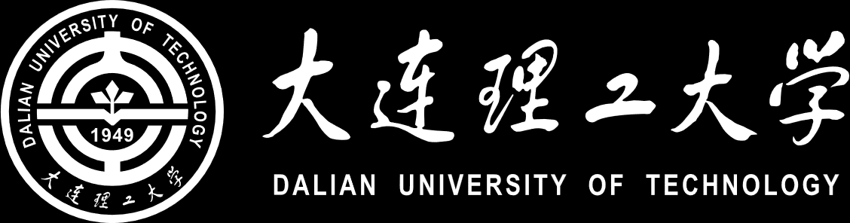
基于GAN的对抗扰动生成算法
A survey on GAN-based adversarial attack methods
汇报人：高文程
A survey on GAN-based adversarial attack methods

Slide 2
1 Adversarial Perturbation
2 White-box Attack
3 Black-box Attack
4 Generative Adversarial Nets
4.1 GAN
4.2 Least Squares GAN
4.3 Wasserstein GAN
5 Adversarial Attack with GANs
5.1 AdvGAN
5.2 AdvGAN++
5.3 Natural Adversaries
Contents

Slide 3

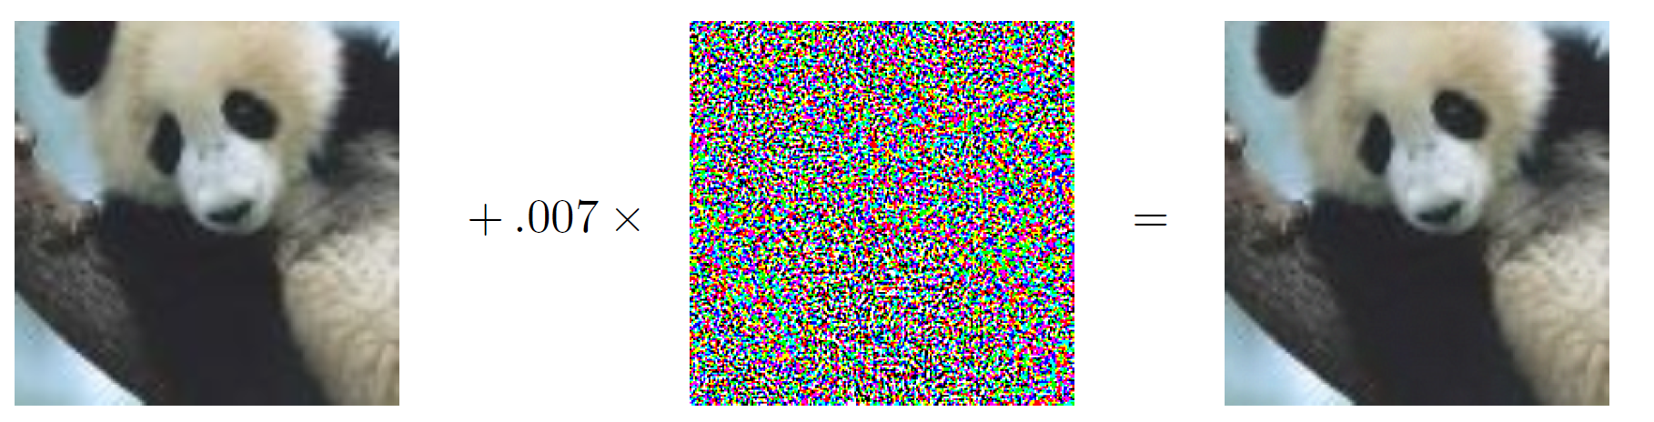
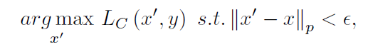
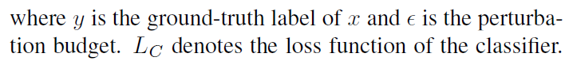
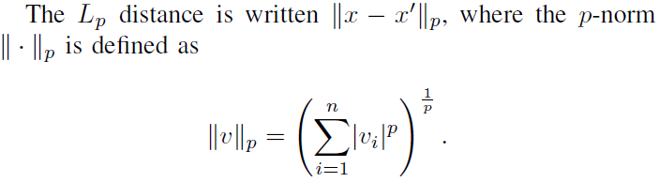
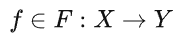
1 Adversarial Perturbation
Definition
CNN model
L0、L2、L-inf
misclassify
References：Madry, A., Makelov, A., Schmidt, L., Tsipras, D., & Vladu, A. (2019). Towards Deep Learning Models Resistant to Adversarial Attacks (arXiv:1706.06083). arXiv. http://arxiv.org/abs/1706.06083
A survey on GAN-based adversarial attack methods
Notes:
假设有一张图片，对这张图片施加人眼不可见的扰动后，分类器会将这张图片误分类，造成误分类的这个扰动就是对抗扰动。寻找对抗扰动一般被描述为一个优化问题：找到对抗样本x’，令x’与y标签的损失函数最大化，限制条件是让扰动限制在一个范围内。这个范围一般用L0，L2，L-inf来表示，L0是指x’与x之间不同像素点的个数，L2是指x’与x的均方误差，L-inf是指x’与x之间的最大差值。

Slide 4
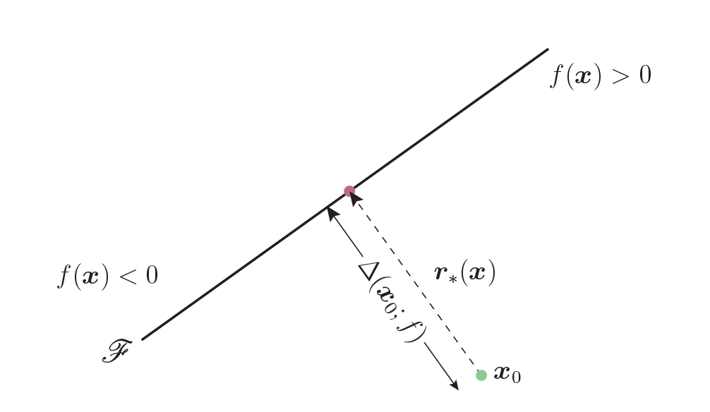
2 White-box Attack
Definition
在生成对抗扰动时，可以完全访问目标模型的训练数据、参数和结构，甚至是防御的参数和结构。
Methods
基于梯度：FGSM、I-FGSM、MI-FGSM、PGD、…
基于决策面：DeepFool、…
基于优化算法：L-BFGS、C&W、…
DeepFool：基于决策面
References：闫嘉乐, 徐洋, 张思聪, & 李克资. (2022). 图像分类模型的对抗样本攻防研究综述. 计算机工程与应用, 58(23), 24–41.
A survey on GAN-based adversarial attack methods
Notes:
对抗扰动可以是白盒攻击，或者是黑盒攻击。白盒攻击是……，方法有……

Slide 5
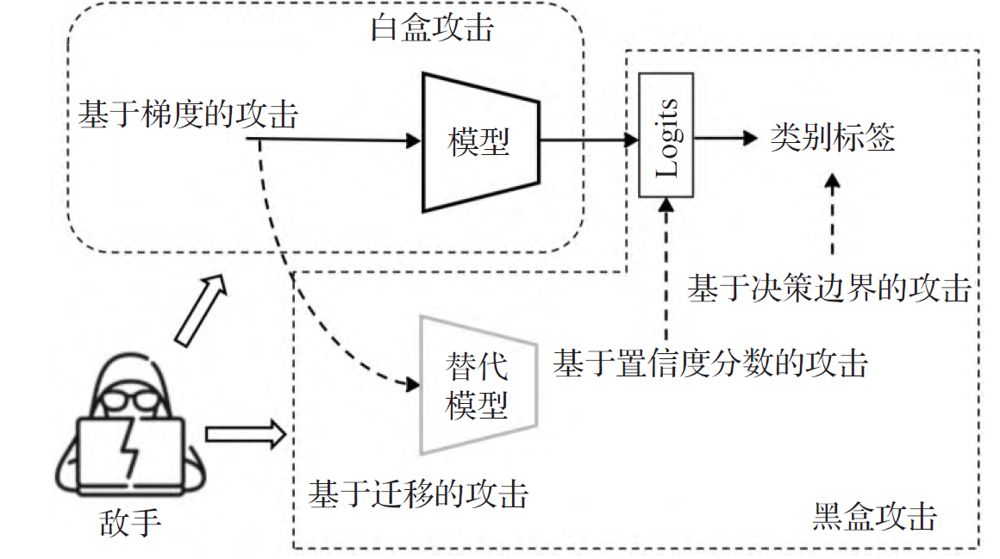
3 Black-box Attack
Definition
在生成对抗扰动时，并不知道目标模型和训练模型的参数，以及防御方法的有关信息。
Methods
基于迁移、基于梯度估算、基于决策边界、基于GAN
References：闫嘉乐, 徐洋, 张思聪, & 李克资. (2022). 图像分类模型的对抗样本攻防研究综述. 计算机工程与应用, 58(23), 24–41.
A survey on GAN-based adversarial attack methods
Notes:
黑盒攻击是……，方法有……

Slide 6
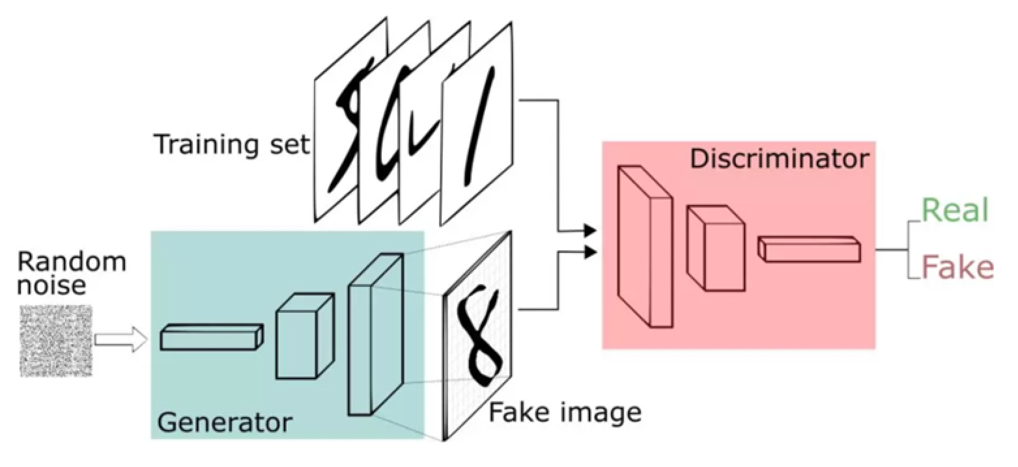
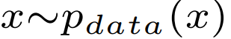
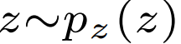
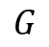
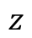
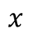
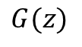
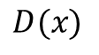
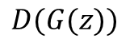
4 Generative Adversarial Nets
4.1 GAN
$$x$$
$$D(x)$$
$$D(G(z))$$
$$z$$
$$G$$
$$G(z)$$
References：https://blog.csdn.net/xujiaqi1574587/article/details/99280913
A survey on GAN-based adversarial attack methods
Notes:
GAN分为生成器和判别器，生成器可以把一个噪声z生成一张假图，判别器判断送入的图片是真图还是假图，再指导生成器生成更逼真的假图。X是真图，G(z)就是假图。

Slide 7
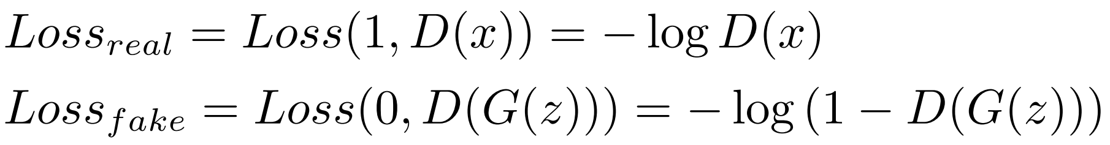
4 Generative Adversarial Nets
4.1 GAN
给定生成器G，判别器D，给定交叉熵损失函数
我们希望判别器D能够分辨正样本和负样本，则：
因此，判别器D的损失为：
Eq. (1)
References：Goodfellow, I., Pouget-Abadie, J., Mirza, M., Xu, B., Warde-Farley, D., Ozair, S., Courville, A., & Bengio, Y. (2014). Generative Adversarial Nets. Advances in Neural Information Processing Systems, 27. https://proceedings.neurips.cc/paper/2014/hash/5ca3e9b122f61f8f06494c97b1afccf3-Abstract.html
A survey on GAN-based adversarial attack methods

Slide 8
4 Generative Adversarial Nets
4.1 GAN
我们希望生成器G生成的负样本接近正样本，因此需要最大化负样本与假标签的距离
Eq. (2)
由Eq. (1)和Eq. (2)得到GAN的优化目标
References：Goodfellow, I., Pouget-Abadie, J., Mirza, M., Xu, B., Warde-Farley, D., Ozair, S., Courville, A., & Bengio, Y. (2014). Generative Adversarial Nets. Advances in Neural Information Processing Systems, 27. https://proceedings.neurips.cc/paper/2014/hash/5ca3e9b122f61f8f06494c97b1afccf3-Abstract.html
A survey on GAN-based adversarial attack methods

Slide 9
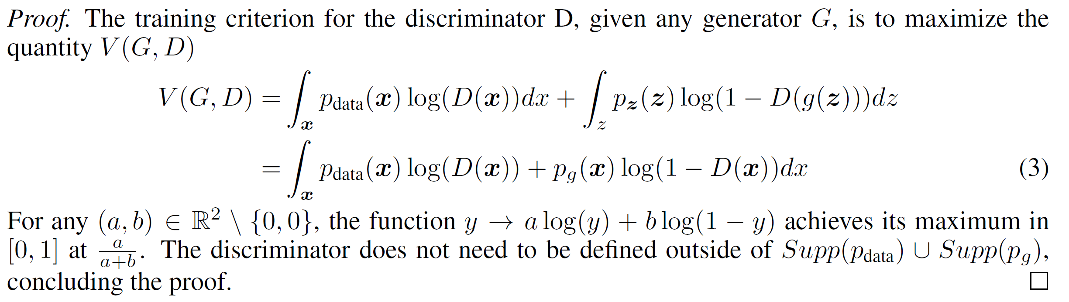
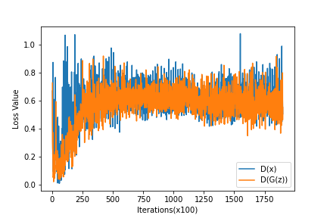
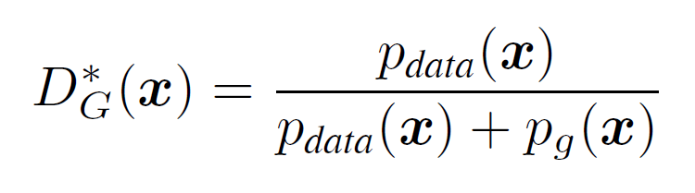
4 Generative Adversarial Nets
4.1 GAN
GAN网络的理想状态：生成器学习到的分布等于原始分布
实际训练
理想状态
纳什均衡
References：Goodfellow, I., Pouget-Abadie, J., Mirza, M., Xu, B., Warde-Farley, D., Ozair, S., Courville, A., & Bengio, Y. (2014). Generative Adversarial Nets. Advances in Neural Information Processing Systems, 27. https://proceedings.neurips.cc/paper/2014/hash/5ca3e9b122f61f8f06494c97b1afccf3-Abstract.html
A survey on GAN-based adversarial attack methods
Notes:
GAN在训练后达到的理想状态是生成器学习的分布完全等于原始的分布。把GAN的价值函数展开，对这个函数求argmax，就可以得到函数最大时的取值。因为pg(x)完全等于pdata(x)，所以D(x)为1/2时函数取最大，生成器和判别器达到一个平衡，称之为纳什均衡。在实际训练时，由于各种因素的影响，D(x)会在1/2附近震荡。

Slide 10
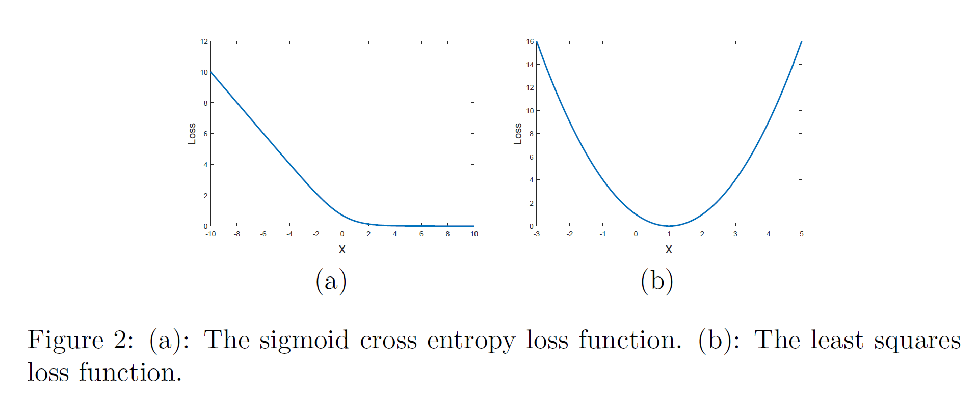
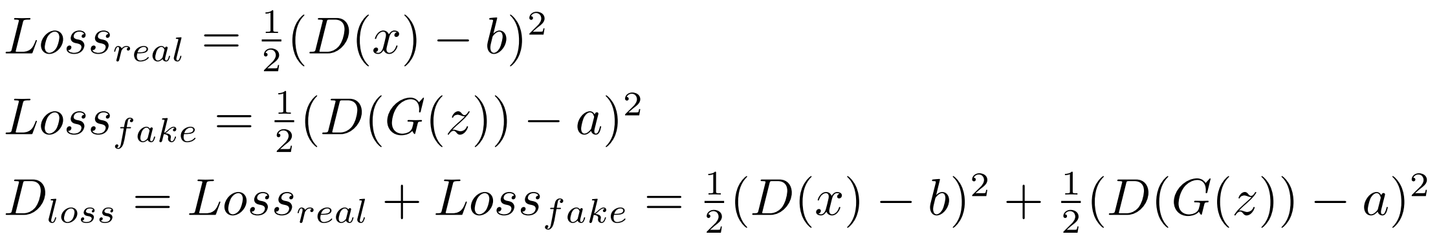
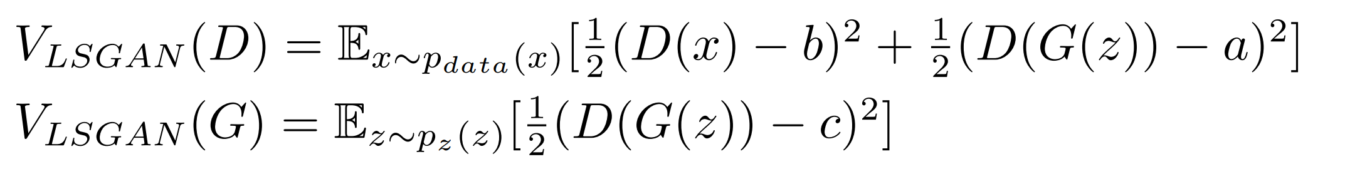
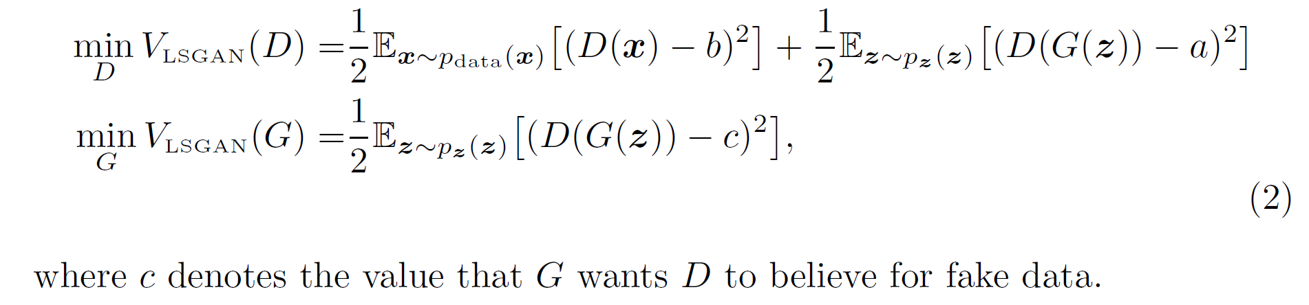
4 Generative Adversarial Nets
4.2 LSGAN
给定Least Squares Loss function：
令假标签为b，真标签为a
可以有效解决训练过程中梯度消失的问题
References：Mao, X., Li, Q., Xie, H., Lau, R. Y. K., Wang, Z., & Smolley, S. P. (2017). Least Squares Generative Adversarial Networks (arXiv:1611.04076). arXiv. http://arxiv.org/abs/1611.04076
A survey on GAN-based adversarial attack methods
Notes:
GAN在理论上没有问题，但是在训练时很容易出现梯度消失，把GAN的交叉熵损失换成最小二乘，就可以解决这个问题。推导过程和前面推导GAN时一样，把真标签换成b，假标签换成a，然后最小化D和G就可以了。

Slide 11
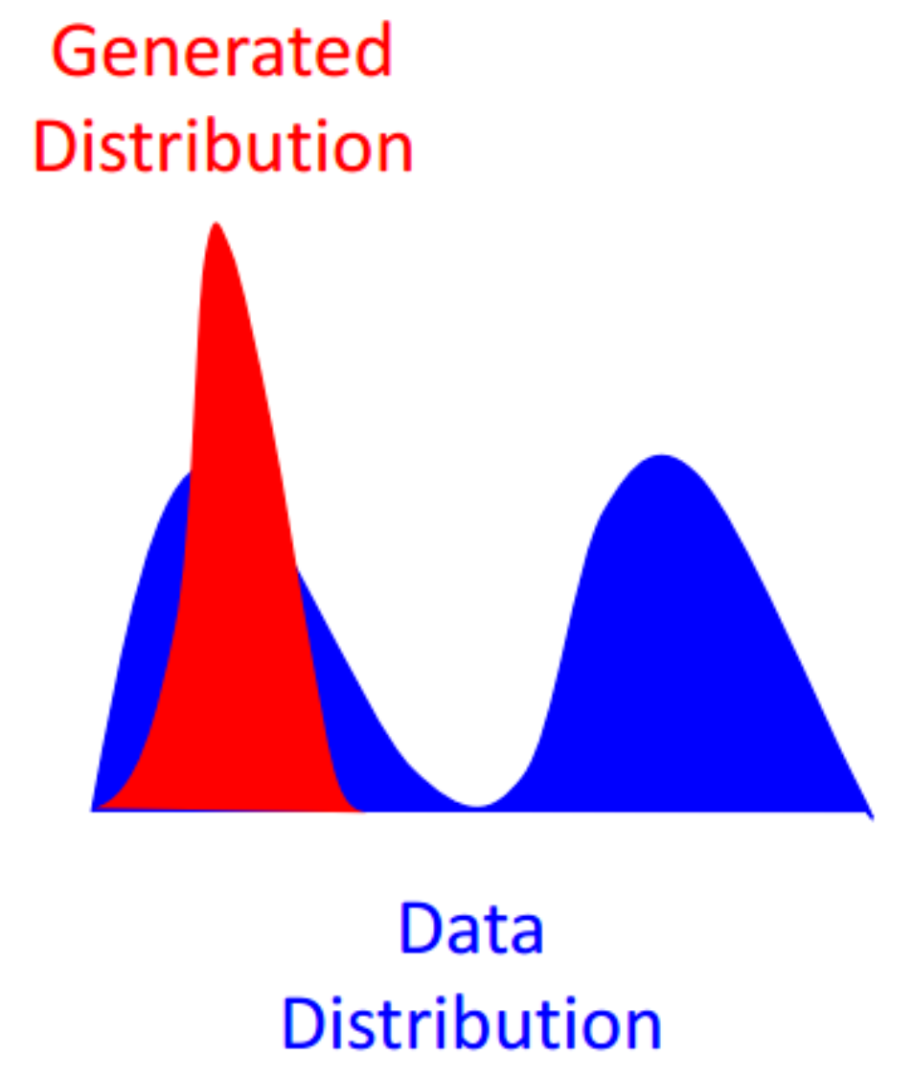
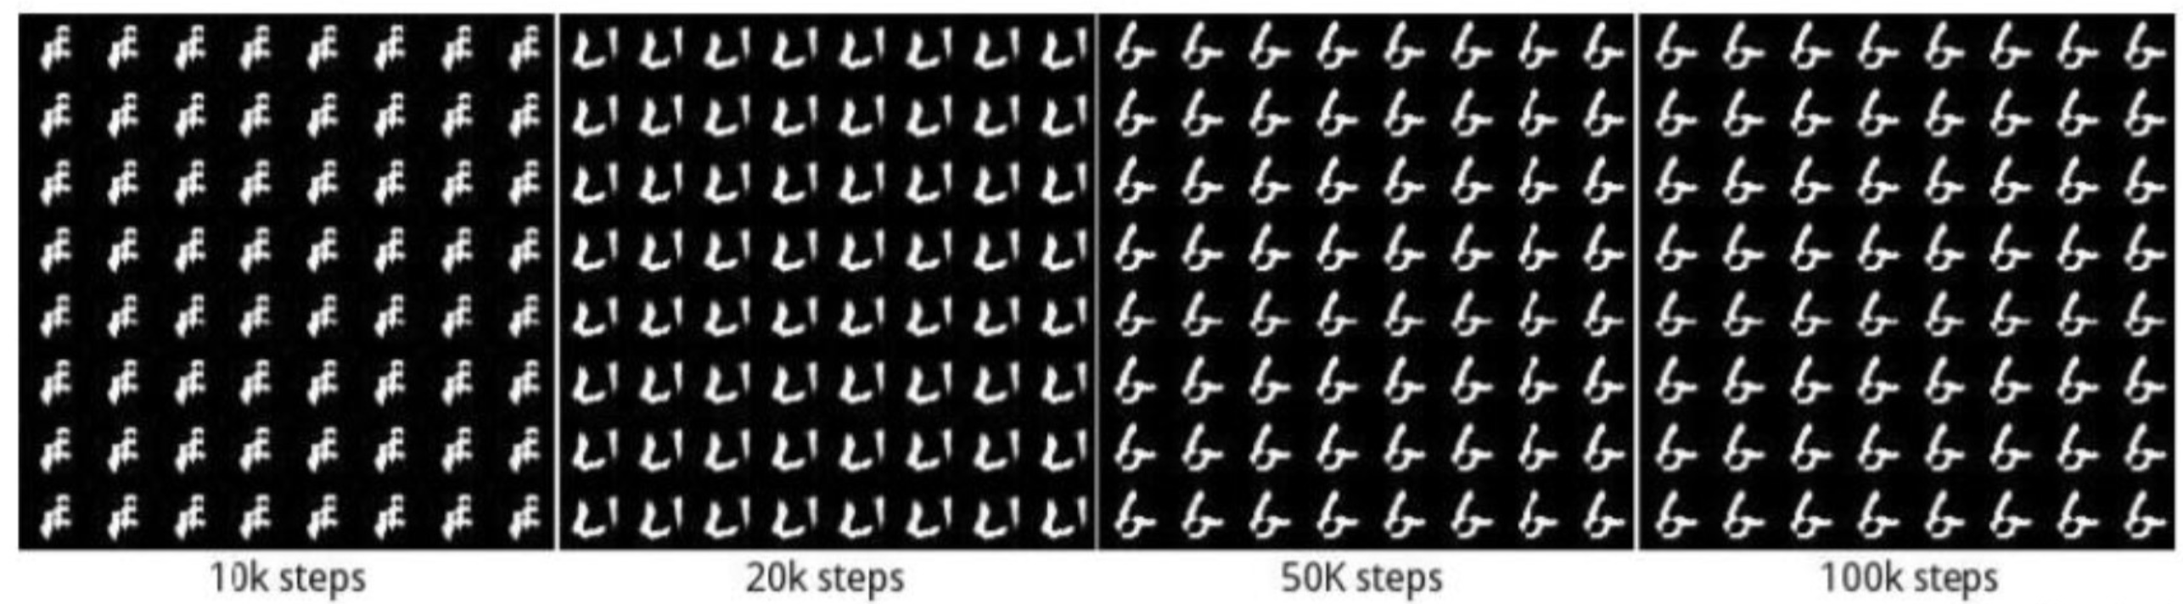
4 Generative Adversarial Nets
JS 散度在分布𝑝和𝑞不重叠时无法平滑地衡量分布之间的距离，从而导致此位置上无法产生有效梯度信息，出现 GAN 训练不稳定的情况。WGAN使用Wasserstein距离，解决了这个问题。
4.3 WGAN
Mode collapse（模式崩塌）
References：Arjovsky, M., Chintala, S., & Bottou, L. (2017). Wasserstein GAN (arXiv:1701.07875). arXiv. http://arxiv.org/abs/1701.07875
A survey on GAN-based adversarial attack methods
Notes:
WGAN不进行过多讨论，只需要知道它可以解决mode collapse问题就可以。模式崩塌是GAN在训练时常见的一个问题，他的意思是生成的分布都集中到一个点来骗过判别器，导致生成的图片多样性很差。WGAN不用js散度来衡量距离，转而用W距离，有效缓解了这个问题。

Slide 12
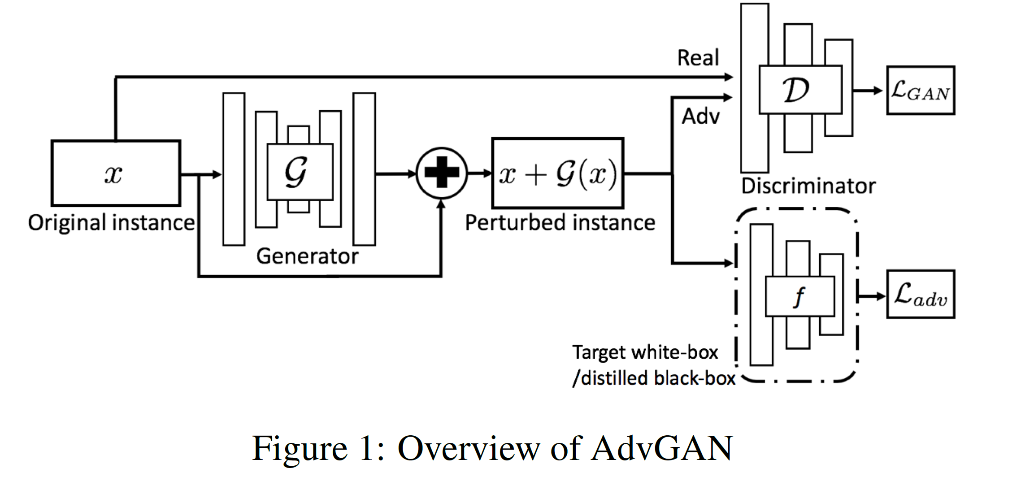
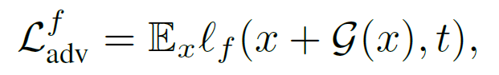
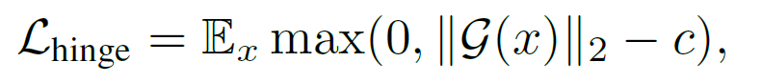
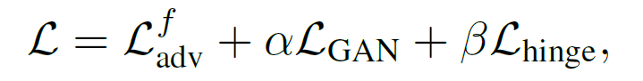
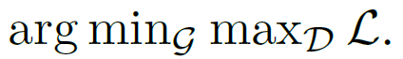
5 Adversarial Attack with GANs
5.1 AdvGAN:
white-box / black-box
target / untarget
References：Xiao, C., Li, B., Zhu, J.-Y., He, W., Liu, M., & Song, D. (2019). Generating Adversarial Examples with Adversarial Networks (arXiv:1801.02610). arXiv. http://arxiv.org/abs/1801.02610
A survey on GAN-based adversarial attack methods
Notes:
给定一张图片x，经过G可以生成这张图片的扰动，然后将扰动施加到x上，去骗过判别器。AdvGAN由三部分损失函数组成，LGAN就是GAN的损失函数，来指导G生成更好的扰动；Ladv是让生成的对抗样本与原样本不相似；Lhinge是限制扰动大小；总的损失函数就是相加。AdvGAN可以进行白盒攻击，也可以用作黑盒攻击。

Slide 13
5 Adversarial Attack with GANs
5.1 AdvGAN:
代入
References：Xiao, C., Li, B., Zhu, J.-Y., He, W., Liu, M., & Song, D. (2019). Generating Adversarial Examples with Adversarial Networks (arXiv:1801.02610). arXiv. http://arxiv.org/abs/1801.02610
A survey on GAN-based adversarial attack methods

Slide 14
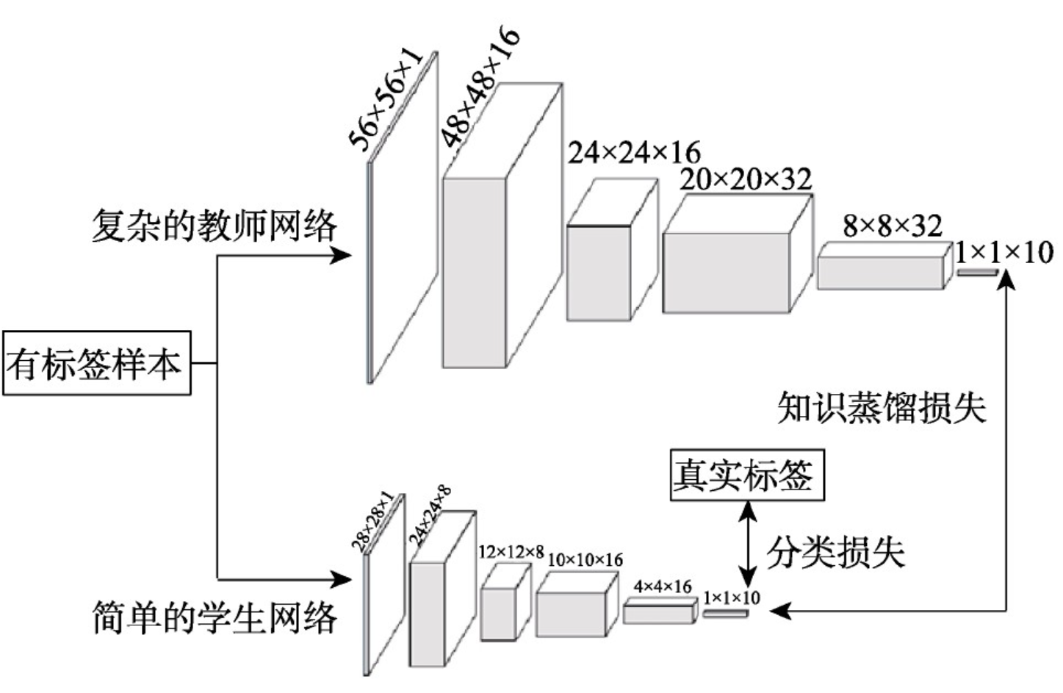
5 Adversarial Attack with GANs
5.1 AdvGAN:
Black-box attack: Knowledge distillation
Teacher Model: 原始模型
Student Model: 替代模型
References：Xiao, C., Li, B., Zhu, J.-Y., He, W., Liu, M., & Song, D. (2019). Generating Adversarial Examples with Adversarial Networks (arXiv:1801.02610). arXiv. http://arxiv.org/abs/1801.02610
A survey on GAN-based adversarial attack methods
Notes:
白盒攻击的情况下很简单，f已知，Ladv可以直接去算。针对黑盒攻击，我们采用模型蒸馏的方法，来学习一个近似原始模型的替代模型。在模型蒸馏中，Student Model在训练时，结合了真实标签和Teacher Model的输出，因此可以近似一个Teacher Model。

Slide 15
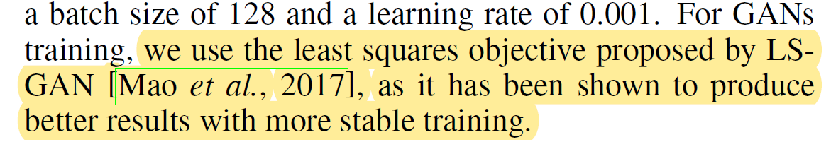
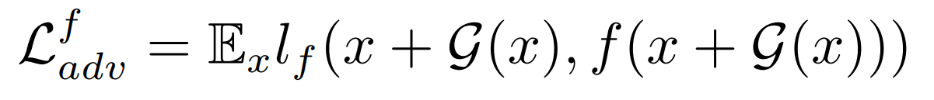
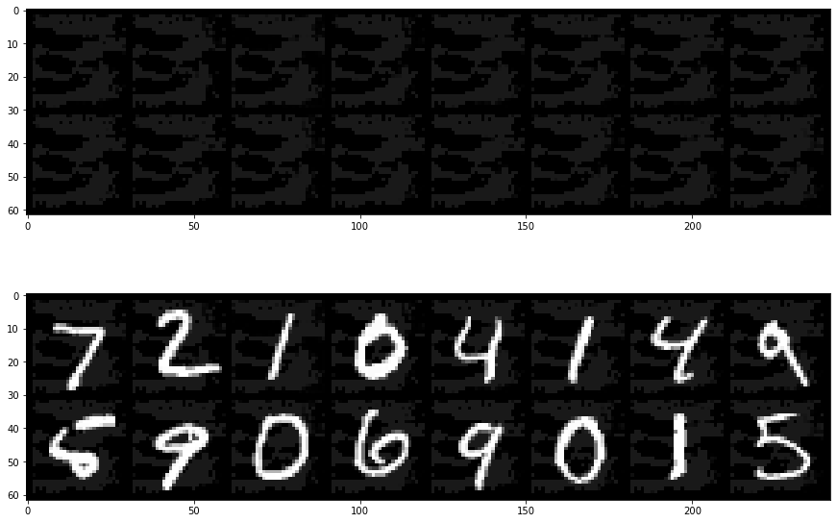
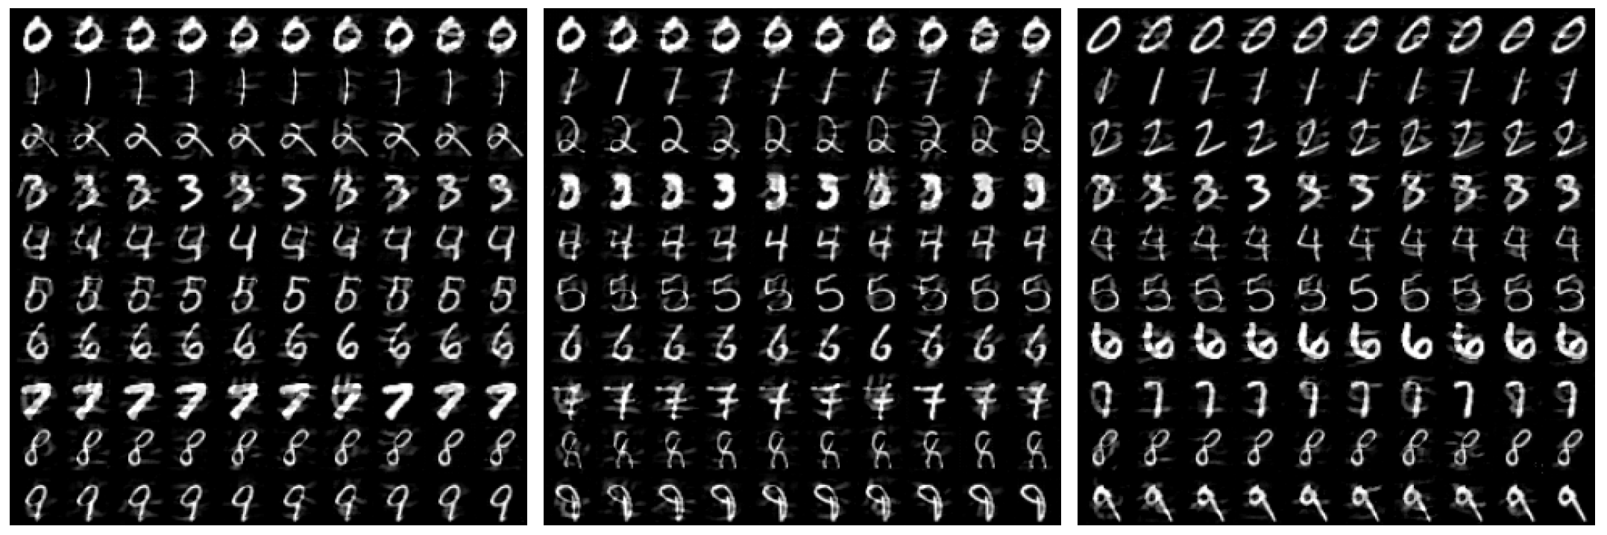
5 Adversarial Attack with GANs
5.1 AdvGAN:
targeted attack
untargeted attack
References：Xiao, C., Li, B., Zhu, J.-Y., He, W., Liu, M., & Song, D. (2019). Generating Adversarial Examples with Adversarial Networks (arXiv:1801.02610). arXiv. http://arxiv.org/abs/1801.02610
A survey on GAN-based adversarial attack methods
Notes:
AdvGAN可以做目标攻击，也可以做无目标攻击。如果是untarget attack，我们可以改一下损失函数，Ladv里可以把这个t换成f(x+G(x))，直接去最大化网络输出与交叉熵损失即可。如果是target attack，我们就最小化网络输出和目标类的距离。论文里对AdvGAN的训练用了LSGAN，来增强训练的稳定性。

Slide 16
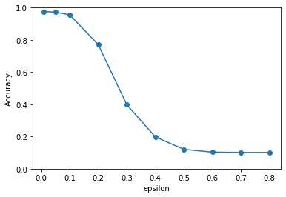
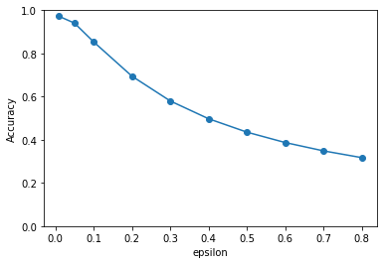
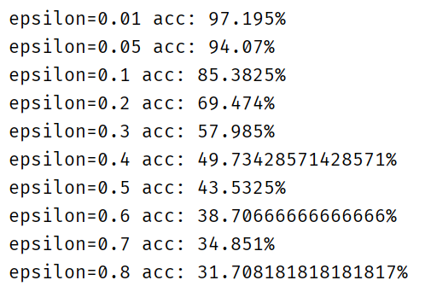
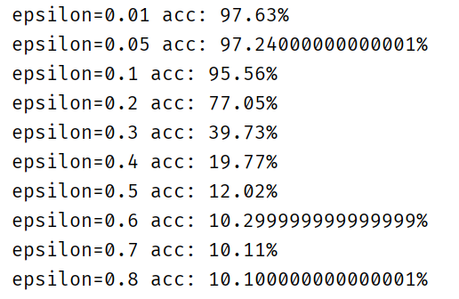
5 Adversarial Attack with GANs
5.1 AdvGAN:
AdvGAN与FGSM实验对比：
目标模型：LeNet（acc: 97.69%）
取epsilon=[0.01, 0.05, 0.1, 0.2, 0.3, 0.4, 0.5, 0.6, 0.7, 0.8]
AdvGAN
FGSM
References：Xiao, C., Li, B., Zhu, J.-Y., He, W., Liu, M., & Song, D. (2019). Generating Adversarial Examples with Adversarial Networks (arXiv:1801.02610). arXiv. http://arxiv.org/abs/1801.02610
A survey on GAN-based adversarial attack methods
Notes:
我简单的对比了一下AdvGAN和之前讲的FGSM的效果，AdvGAN相比于FGSM效果是好很多的

Slide 17
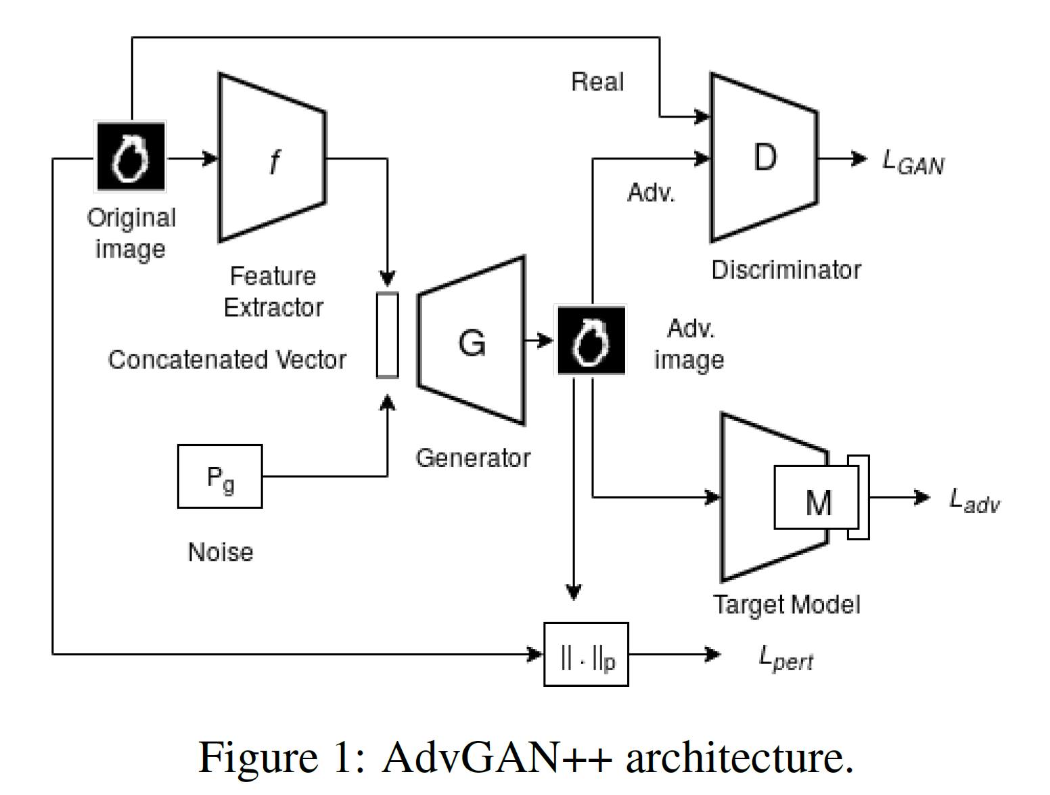
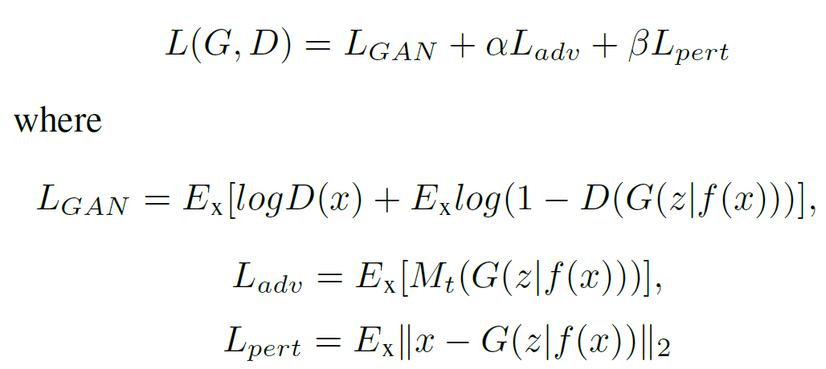
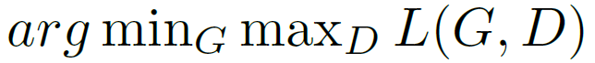
5 Adversarial Attack with GANs
5.2 AdvGAN++:
References：Mangla, P., Jandial, S., Varshney, S., & Balasubramanian, V. N. (2019). AdvGAN++: Harnessing latent layers for adversary generation (arXiv:1908.00706). arXiv. http://arxiv.org/abs/1908.00706
A survey on GAN-based adversarial attack methods

Slide 18
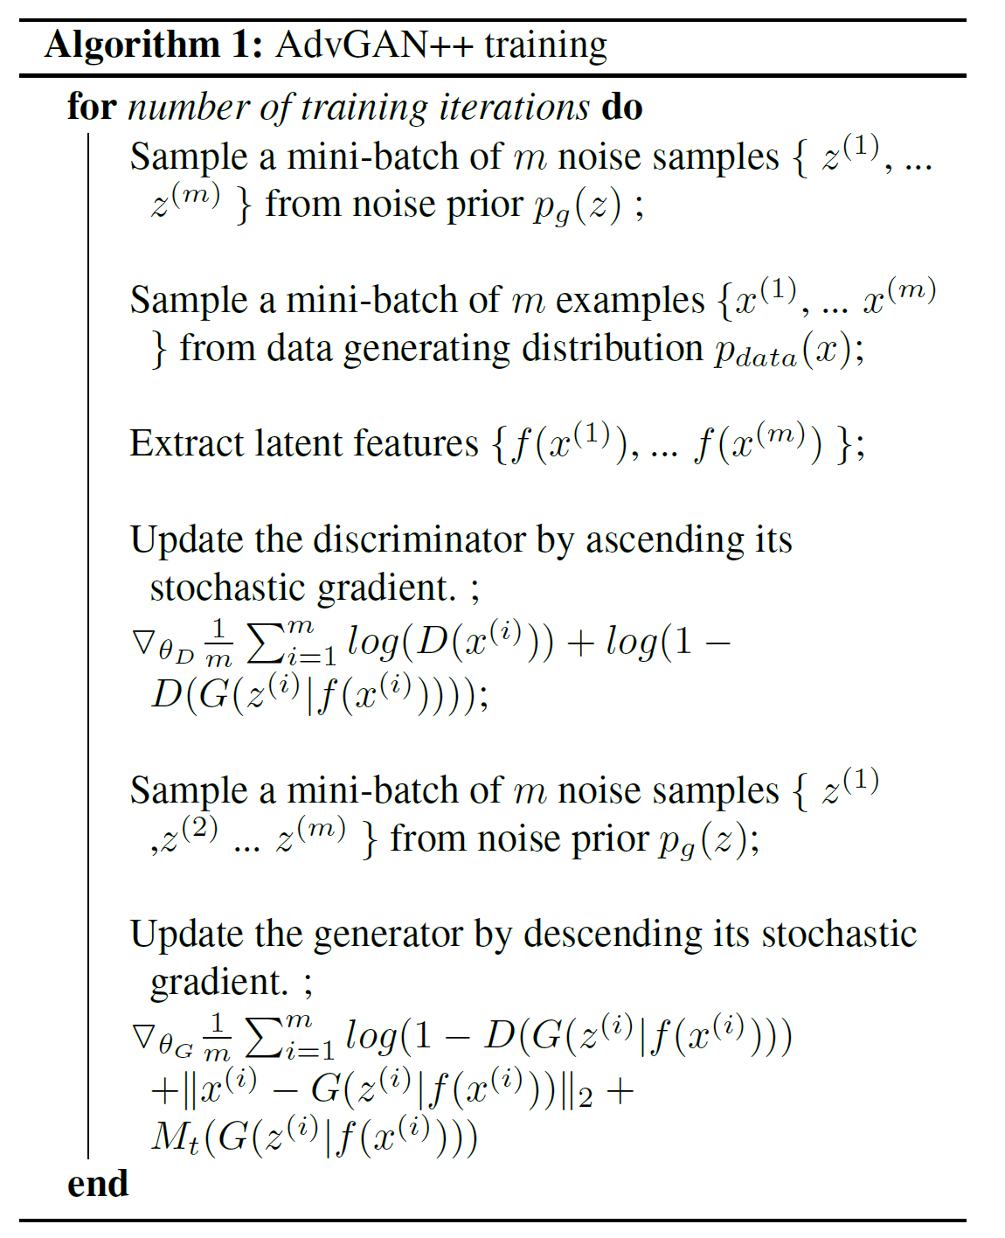
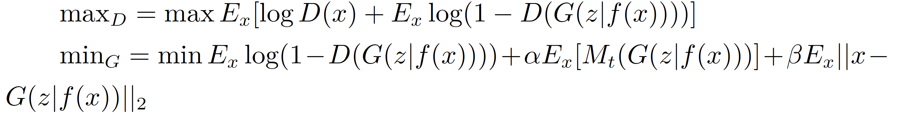
5 Adversarial Attack with GANs
5.2 AdvGAN++:
References：Mangla, P., Jandial, S., Varshney, S., & Balasubramanian, V. N. (2019). AdvGAN++: Harnessing latent layers for adversary generation (arXiv:1908.00706). arXiv. http://arxiv.org/abs/1908.00706
A survey on GAN-based adversarial attack methods

Slide 19
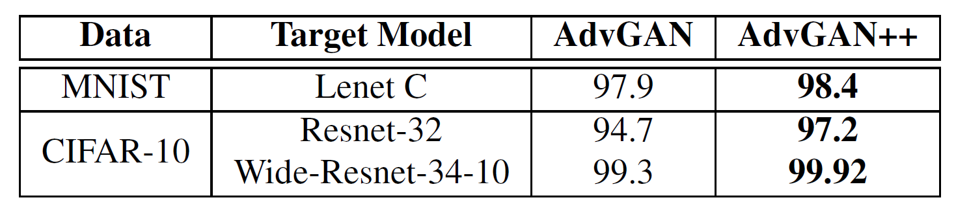
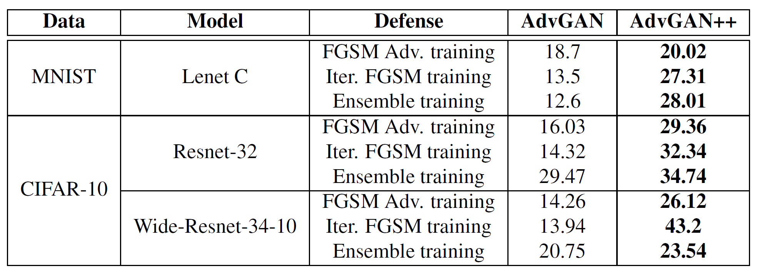
5 Adversarial Attack with GANs
5.2 AdvGAN++:
Target model under no defense
Target model under defense
References：Mangla, P., Jandial, S., Varshney, S., & Balasubramanian, V. N. (2019). AdvGAN++: Harnessing latent layers for adversary generation (arXiv:1908.00706). arXiv. http://arxiv.org/abs/1908.00706
A survey on GAN-based adversarial attack methods

Slide 20
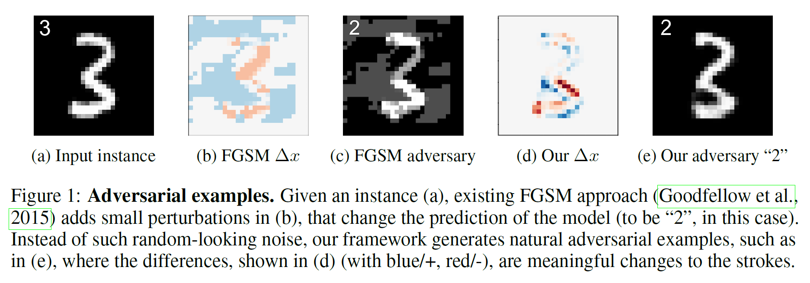
5 Adversarial Attack with GANs
5.3 Generating Natural Adversarial Examples
References：Zhao, Z., Dua, D., & Singh, S. (2018). Generating Natural Adversarial Examples (arXiv:1710.11342). arXiv. http://arxiv.org/abs/1710.11342
A survey on GAN-based adversarial attack methods

Slide 21
5 Adversarial Attack with GANs
5.3 Generating Natural Adversarial Examples
Method：
不同于之前显示的在原始数据空间上寻找对抗样本，本文在Latent Space（隐空间）中找到对抗样本，然后将Latent Space的数据解码到真实数据空间中。
真实数据 -> 隐空间：Inverter
隐空间 -> 真实数据：Generator
References：Zhao, Z., Dua, D., & Singh, S. (2018). Generating Natural Adversarial Examples (arXiv:1710.11342). arXiv. http://arxiv.org/abs/1710.11342
A survey on GAN-based adversarial attack methods

Slide 22
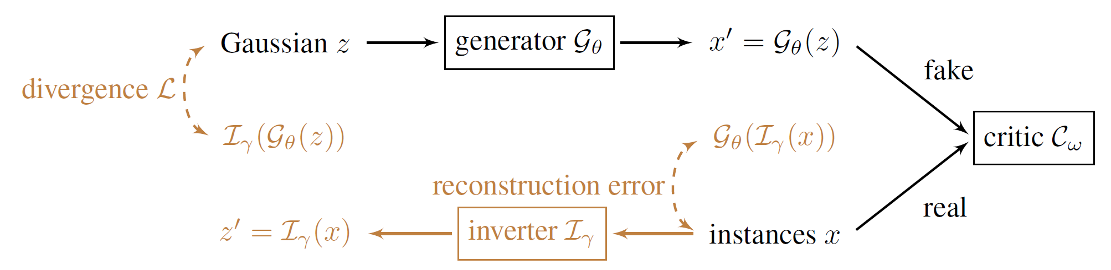
5 Adversarial Attack with GANs
5.3 Generating Natural Adversarial Examples
1. 真实数据 -> 隐空间：Inverter
References：Zhao, Z., Dua, D., & Singh, S. (2018). Generating Natural Adversarial Examples (arXiv:1710.11342). arXiv. http://arxiv.org/abs/1710.11342
A survey on GAN-based adversarial attack methods

Slide 23
5 Adversarial Attack with GANs
5.3 Generating Natural Adversarial Examples
2. 隐空间 -> 真实数据：Generator
References：Zhao, Z., Dua, D., & Singh, S. (2018). Generating Natural Adversarial Examples (arXiv:1710.11342). arXiv. http://arxiv.org/abs/1710.11342
A survey on GAN-based adversarial attack methods

Slide 24

5 Adversarial Attack with GANs
5.3 Generating Natural Adversarial Examples
References：Zhao, Z., Dua, D., & Singh, S. (2018). Generating Natural Adversarial Examples (arXiv:1710.11342). arXiv. http://arxiv.org/abs/1710.11342
A survey on GAN-based adversarial attack methods

Slide 25

5 Adversarial Attack with GANs
5.3 Generating Natural Adversarial Examples
References：Zhao, Z., Dua, D., & Singh, S. (2018). Generating Natural Adversarial Examples (arXiv:1710.11342). arXiv. http://arxiv.org/abs/1710.11342
A survey on GAN-based adversarial attack methods

Slide 26

5 Adversarial Attack with GANs
5.3 Generating Natural Adversarial Examples
References：Zhao, Z., Dua, D., & Singh, S. (2018). Generating Natural Adversarial Examples (arXiv:1710.11342). arXiv. http://arxiv.org/abs/1710.11342
A survey on GAN-based adversarial attack methods

Slide 27
Thanks for Wathing!

